Slide 1
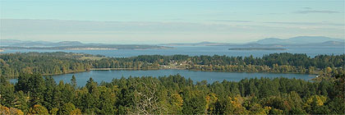

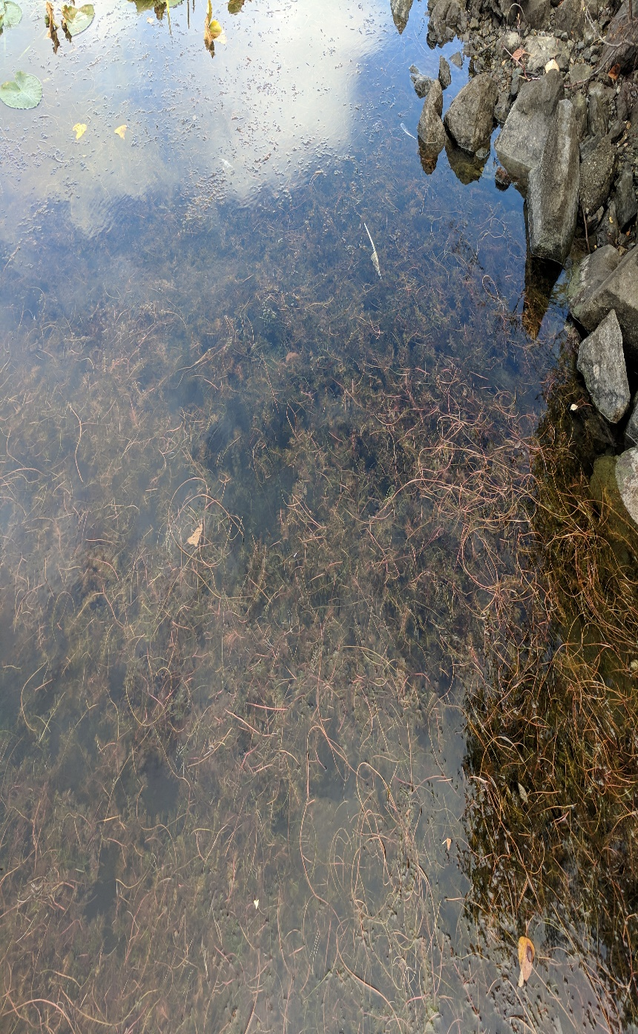
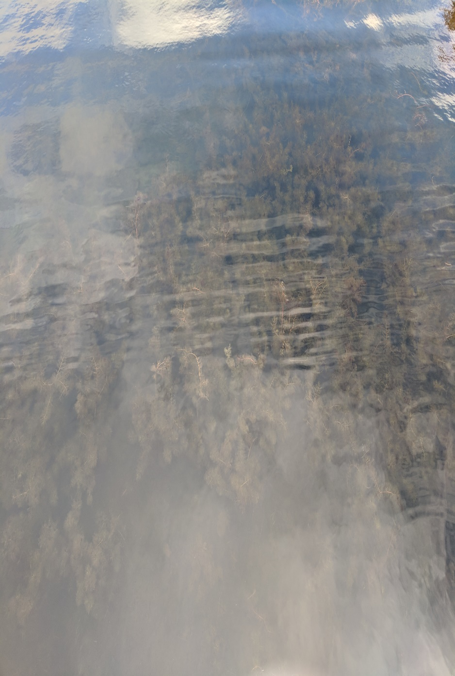
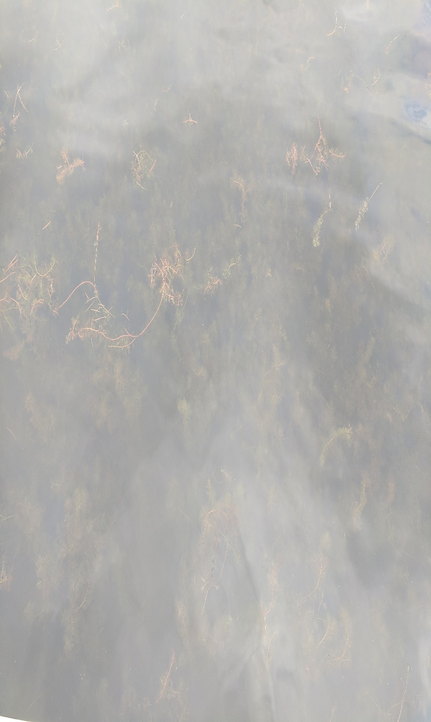
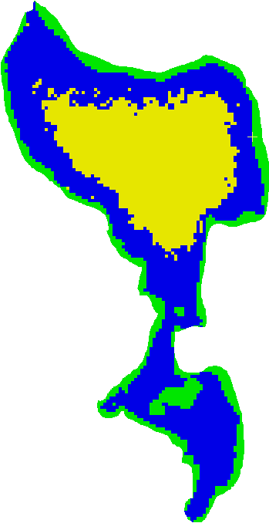
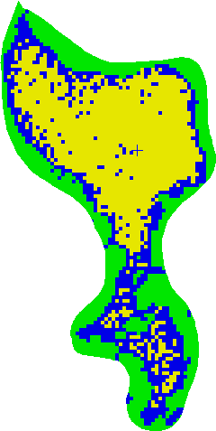
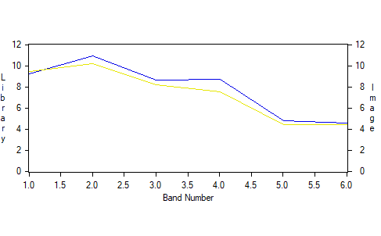
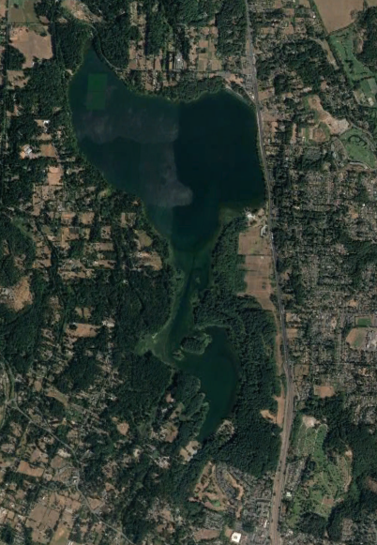
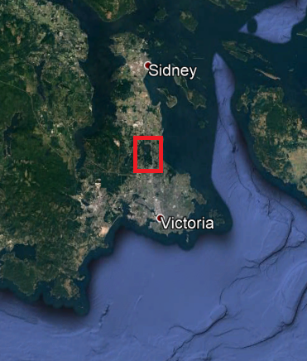
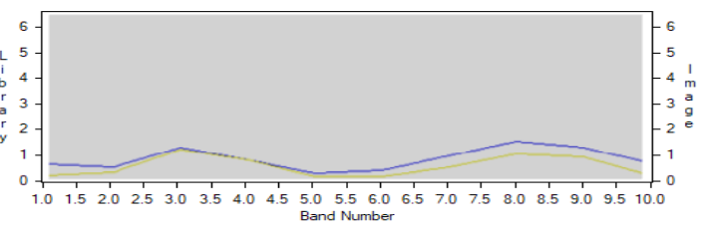

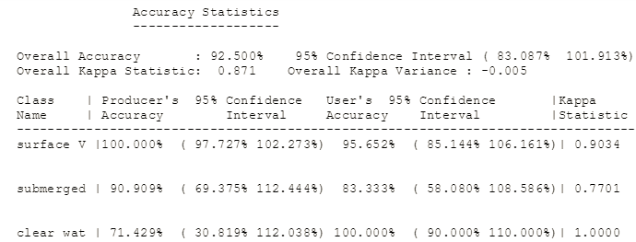
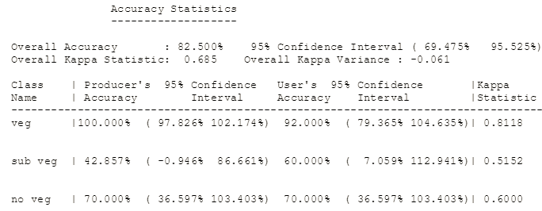
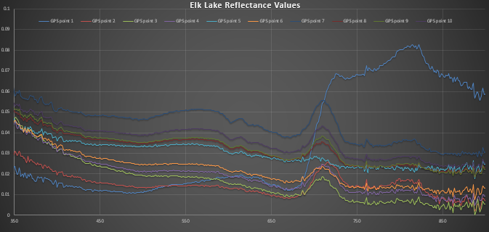
Historical Comparison of Vegetation in Elk Lake
Russell Brown
Griffin Troup
University of Victoria, Department of Geography
Introduction:
With more than one million visitors every year, Elk Lake is one of the most popular locations in Victoria. It is home to both the national and University of Victoria rowing teams and is also a popular fishing destination (Sandborn and Gray, 2015). There are a couple issues that have been plaguing the lake recently, these are algae blooms and aquatic vegetation. This study looked at aquatic vegetation negatively impacting lake activities. The have used an aquatic weed harvester to help remove some of the vegetation in areas that are most frequently used (Cleverley, 2017). With an estimated 14,000 angler days annually, there is a need to be able to determine where vegetation is (CRD, 2015). Vegetation can impact boats propellers as well as interfere with the fishing itself making it a nuisance for many users of the lake.
The goal of this report is to classify aquatic vegetation in Elk Lake to determine where higher concentrations are located and how that may have differed historically.
There were multiple levels of vegetation at the docks. The concentration decreases the further down the dock as seen left to right in the above image
Discussion:
The classified Sentinel image does a good job at separating the specific classes as the final image makes sense with higher concentrations in the shallow near-shore waters. There is a higher amount of vegetation in the sentinel image and this could be due to a couple different factors. The spatial resolution of the sentinel image is higher than Landsat, which means less pixel mixing in the near-shore environment. The accuracy of the classification was also higher for the Sentinel image, this was mostly due to the difference in pixel size and adjacency in the near-shore.
The higher vegetation values in Sentinel could also be due to the big algae bloom creating a greener reflectance which can be similar to vegetation. This is especially apparent in Beaver Lake, the southern most portion of the lake. The 2017 Sentinel image was taken while Beaver Lakes water is very green due to the algae bloom. Differences in vegetation detection in this area may be attributed to bloom and non-bloom conditions between the years.
The vegetation patch that can be seen in Beaver Lake is a small island covered in vegetation, so it was appropriately classified as such. Beaver Lake is not nearly as deep as Elk Lake and this can be seen with the vegetation levels found in Beaver Lake. The deep parts of Elk Lake are clear of vegetation and this could be in part due to the harvester that removes vegetation. The main areas for clearing are the beaches and rowing routes.
When looking at the accuracy statistics for both classifications, the areas with the most error was the submerged vegetation class. This due to the difficulty in separating submerged vegetation from clear water. Land vegetation was the easiest to classify as it had no relation to the water body, meaning quite different reflectance values.
When simulating the hyperspectral data into bands from Landsat and Sentinel there were specific bands that allowed for vegetation detection. Landsat bands located in the near infrared, green and blue areas of the spectrum were able to differentiate between reflectance values better than the other bands. Sentinel bands 7 and 8 located in the near infrared part of the spectrum contained the greatest separation between other reflectance values.
Study Area:
Results:
Results:
Sentinel Classification Accuracy Report Landsat Classification Accuracy Report
The two classified images display areas with vegetation, submerged vegetation and no vegetation.
There spectra reports are included below to display reflectance values for each class in the different
bands for each satellite. The classified Sentinel image had an overall accuracy of 92.5% while the
Landsat image had an overall accuracy of 82.5%.
Classified Landsat Spectra Report
Classified Sentinel Spectra Report
Classified Sentinel Image
Classified Landsat Image
Conclusion:
The final maps show us that using a higher spatial resolution can play a big part in the overall accuracy of vegetation detection. If this were on a larger scale than it may have been better but due to the pixel mixing in the near-shore, some accuracy was lost. Access to higher spatial resolution imagery would greatly aid in the ability to separate classes with a higher accuracy.
The 2017 image is known to have been taken during an algae bloom (CBC News, 2017), this could affect reflectance values when looking for vegetation. The use of a boat could have aided in data collection if more shallow areas were able to be sampled. Creating these maps show us that the main issues are all around the edges which are the shallowest areas. This means the popular beach spots should be a priority to clear, along with other busy spots near shallow water.
Data:
Primary Data: All collected on October 20, 2017.
-GPS Points for each site
-Hyperspectral data from the handheld
spectroradiometer
Secondary Data:
-Sentinal 2 image from October 3rd, 2017
-Landsat 7 image from October 31, 2002
Methods:
Hyperspectral imagery was recorded using the docks at Elk
Lake. There were five sites each dock, for a total of ten sites.
Imagery was collected from the start of the dock where there was
the highest concentrations of vegetation. These were located at
sites 1 and 10 as these were closest to the shore. Sites 5 and
6 had the lowest amount of vegetation due to the increasing depth
of the water.
Both satellite images were downloaded and atmospherically
corrected in order to compare the reflectance in different regions of
the lake. The different reflectance values were used to create a
classification of the different vegetation levels in the lake. The
Sentinel classification was run using a maximum likelihood
classification, while the Landsat was done with a minimum
distance classification.
References:
Cleverley, B (2017, July 15). Million-dollar algae fix pitched for Elk Lake. Retrieved November
22, 2017, from http://www.timescolonist.com/news/local/million-dollar-algae-fix-pitched-
For-elk-lake-1.21164602
Sandborn, C., & Gray, E. (2015, October 23). Comment: Everyone's help needed to save Elk,
Beaver lakes. Retrieved November 18, 2017, from http://www.timescolonist.com/opinion/
op-ed/comment-everyone-s-help-needed-to-save-elk-beaver-lakes-1.2094200
CRD. (2015). Water Quality Sampling Program for Elk Lake 2014-2015: Overview, Status
and Phosphorus Budget. Retrieved November 22, 2017, from https://www.crd.bc.ca/docs
/default-source/initiatives-pdf/gwi-pdf/other-reports/2015waterqualityreportelklake-rnor
din.pdf?sfvrsn=6.
CBC News. (2017, July 20). Toxic blue-green algae ends swimming at popular Victoria lake.
Retrieved November 23, 2017, from http://www.cbc.ca/news/canada/british-columbia/
Blue-green-algae-beaver-lake-1.4214729
Heading image retrieved from: http://www.explorevancouverisland.com/Dominion_
Observatory_Vancouver_Island_BC.htm
Figure:1 Hyperspectral data from the handheld Spectroradiometer
This spectroadiometers data shows that when detecting aquatic vegetation there was a strong reflectance in the near infrared band.

